Slide 1
Lecture 3 Neural networks
CS 180 – Intelligent Systems
Dr. Victor Chen
Fall 2022

Slide 2
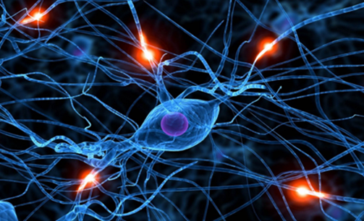
Neural networks

Slide 3
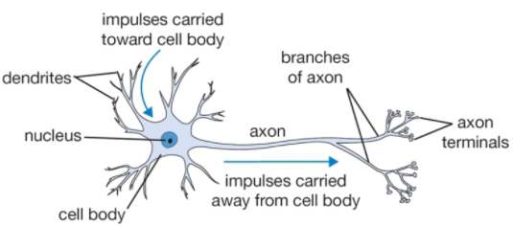
Neural networks
Neural networks are collections of neurons.
One neuron is a weighted sum, followed by an activation function.

Slide 4
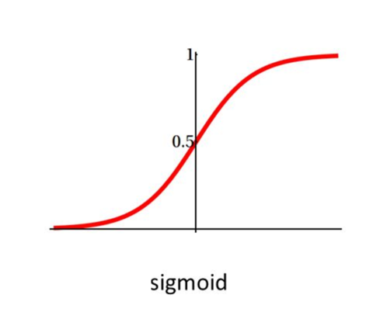
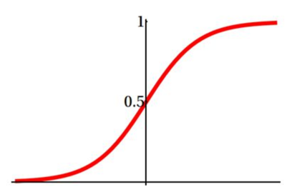
Neuron with sigmoid = Logistic regression
Input
Bias b
Weights
x₁
w₁
x₂
w₂
Output: σ(w⋅x + b)
x₃
w₃
.
.
.
Sigmoid function:
w_{d}
x_{d}

Slide 5
Neuron with linear function = Linear regression
Input
Bias b
Weights
x₁
w₁
x₂
w₂
Output: σ(w⋅x + b)
x₃
w₃
.
.
.
linear function:
w_{d}
x_{d}

Slide 6
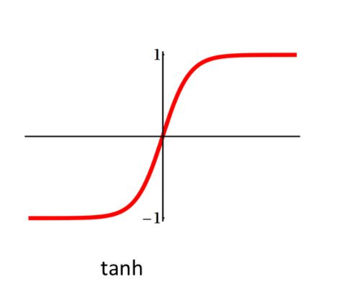
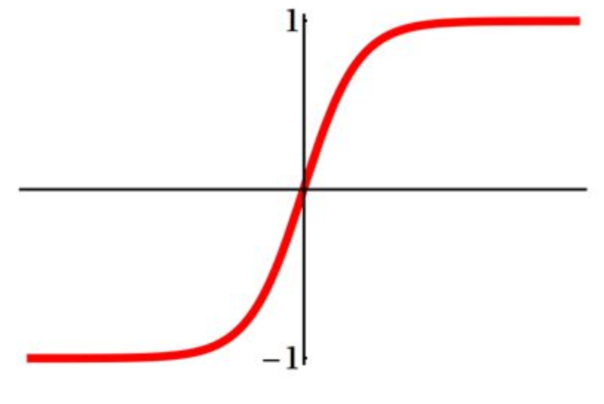
Neuron with Tanh function

Slide 7
Neuron with ReLU function
Rectified linear unit (ReLU): σ(t) = max(0,t)

Slide 8
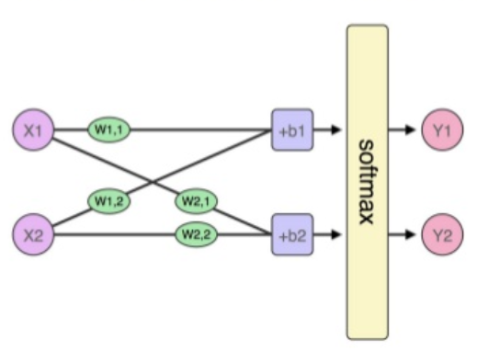
Model with two outputs
We can put two neurons in parallel

Slide 9
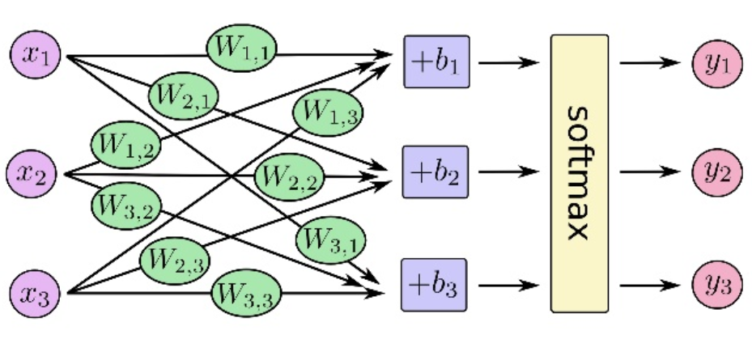
Model with three outputs
We can put three neurons in parallel

Slide 10
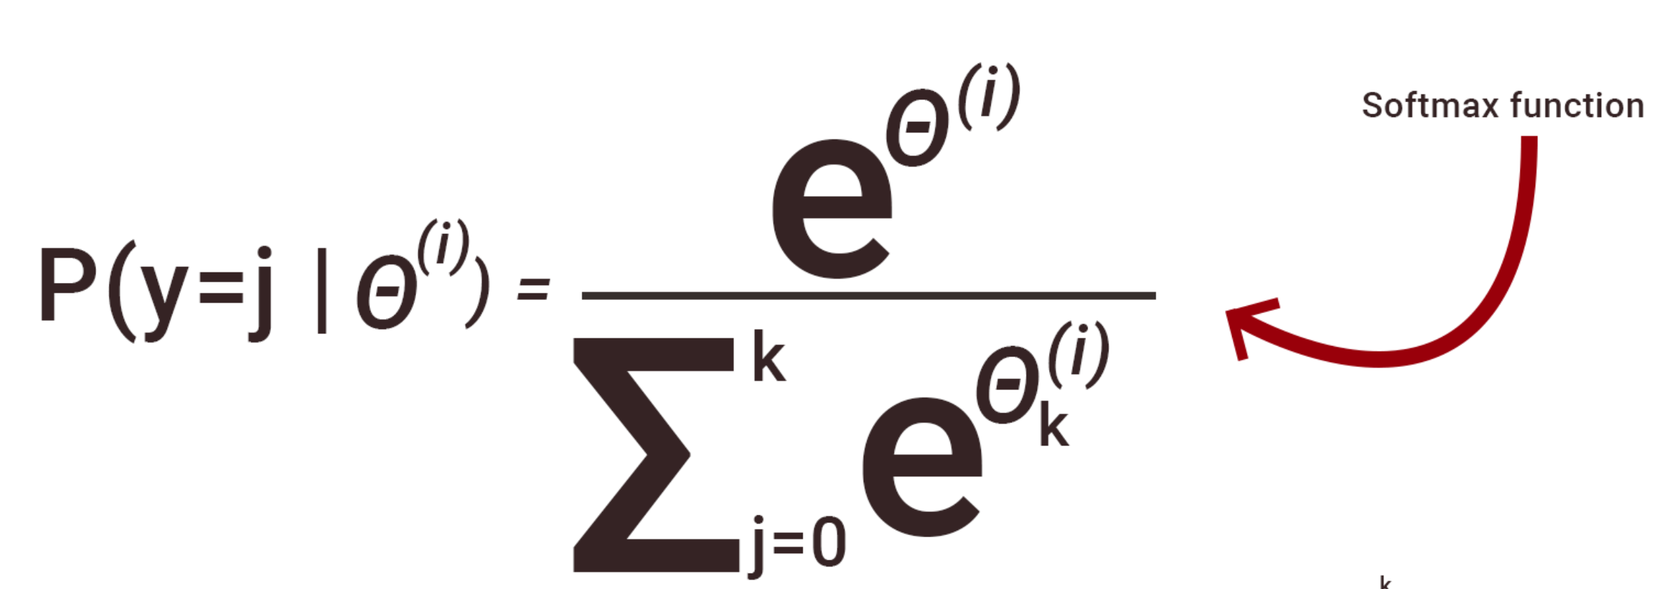
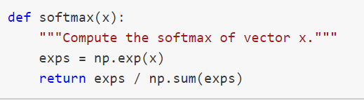
Softmax implementation
np.exp(x): Calculate the exponential of x

Slide 11
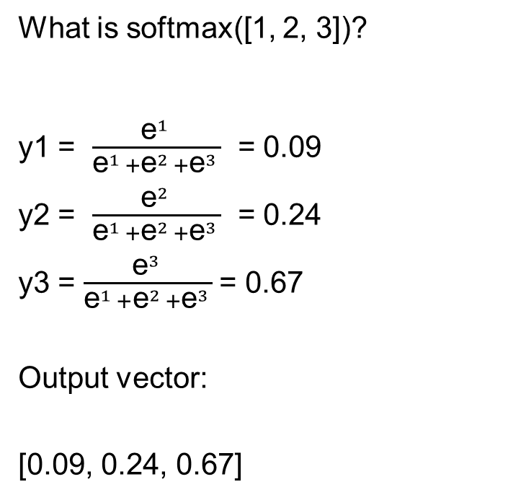
Softmax example
What is softmax([1, 2, 3])?
y1 = $\frac{{\text{e}}^{1 }}{{\text{e}}^{1 }+{\text{e}}^{2 }+{\text{e}}^{3 }}$ = 0.09
y2 = $\frac{{\text{e}}^{2 }}{{\text{e}}^{1 }+{\text{e}}^{2 }+{\text{e}}^{3 }}$ = 0.24
y3 = $\frac{{\text{e}}^{3 }}{{\text{e}}^{1 }+{\text{e}}^{2 }+{\text{e}}^{3 }}$= 0.67
Output vector:
[0.09, 0.24, 0.67]

Slide 12
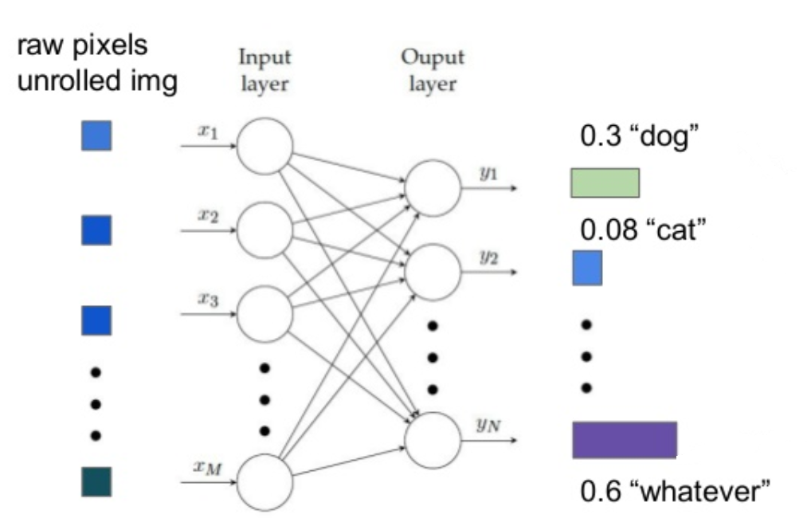
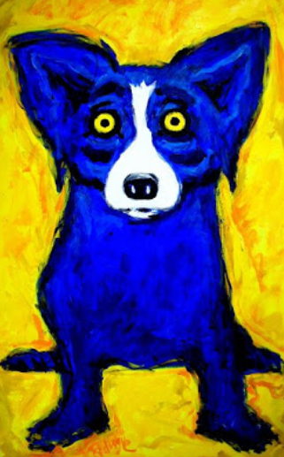
Neutral Network for image classification
Build a multi-layer neural network! One output neuron for one class

Slide 13

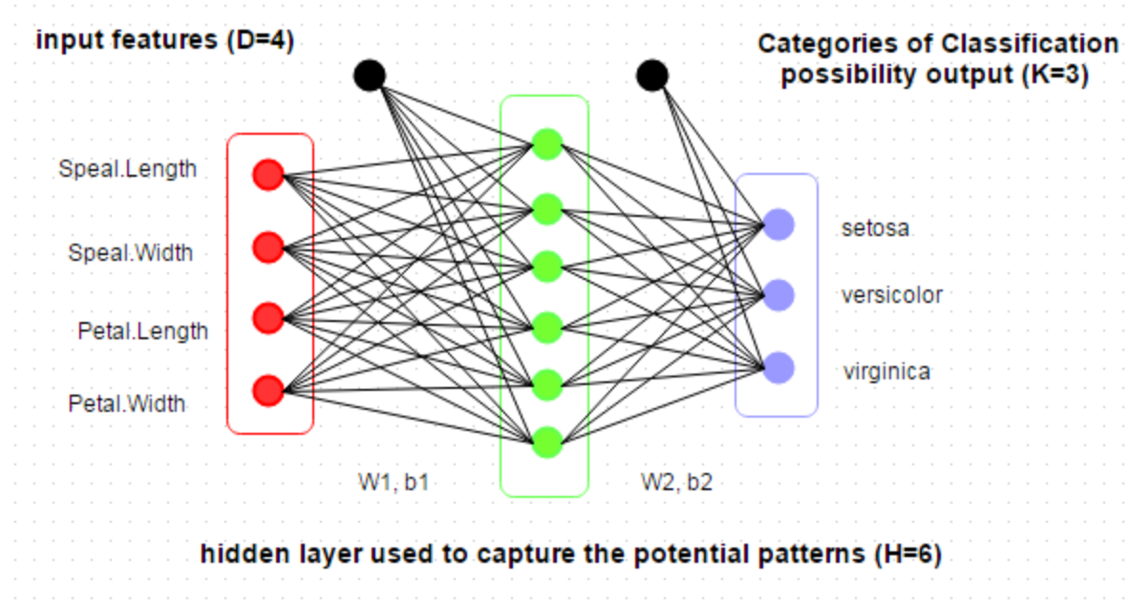
Softmax
Softmax function is used to ensure that the model output will be a probabilistic distribution, i.e., it converts any given vector to a distribution.
setosa, versicolor, virginica?
0.09
0.24
0.67

Slide 14
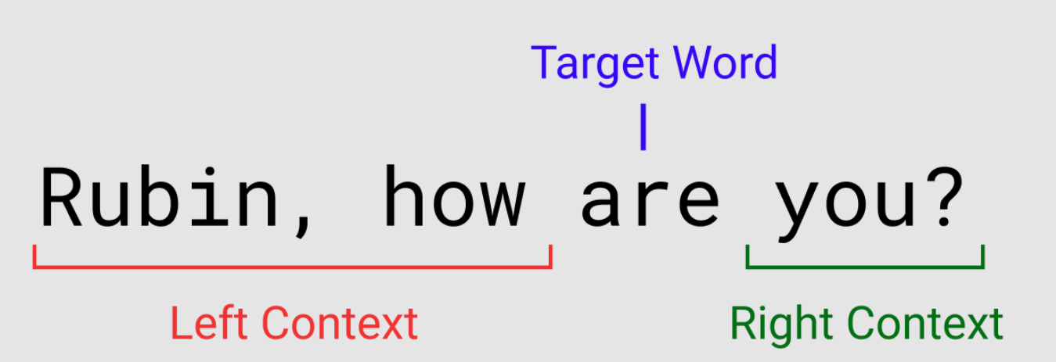
Neutral network for language processing

Slide 15
Training of multi-layer networks
Goal: Find edge weights to minimize the error between “true” and “predicted” labels of training records:

Slide 16
Training of multi-layer networks
https://ml4a.github.io/demos/simple_forward_pass/

Slide 17
How to update model weights: gradient descent
Update weights by gradient descent:
α here is called learning rate.
Gradient update

Slide 18
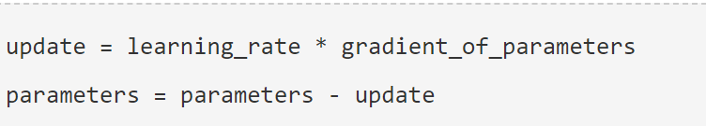
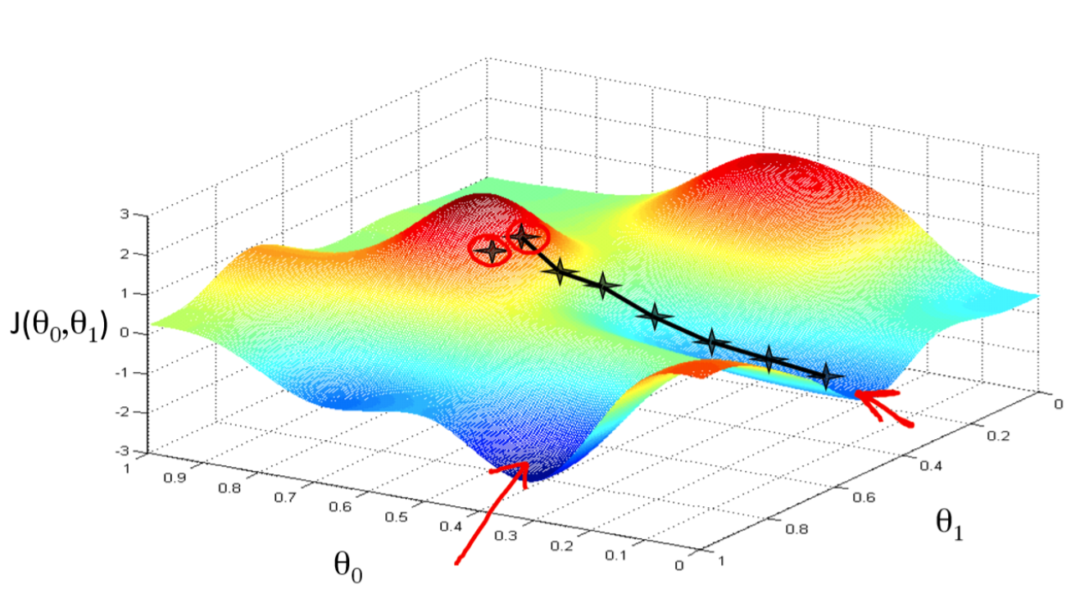
Gradient descent

Slide 19
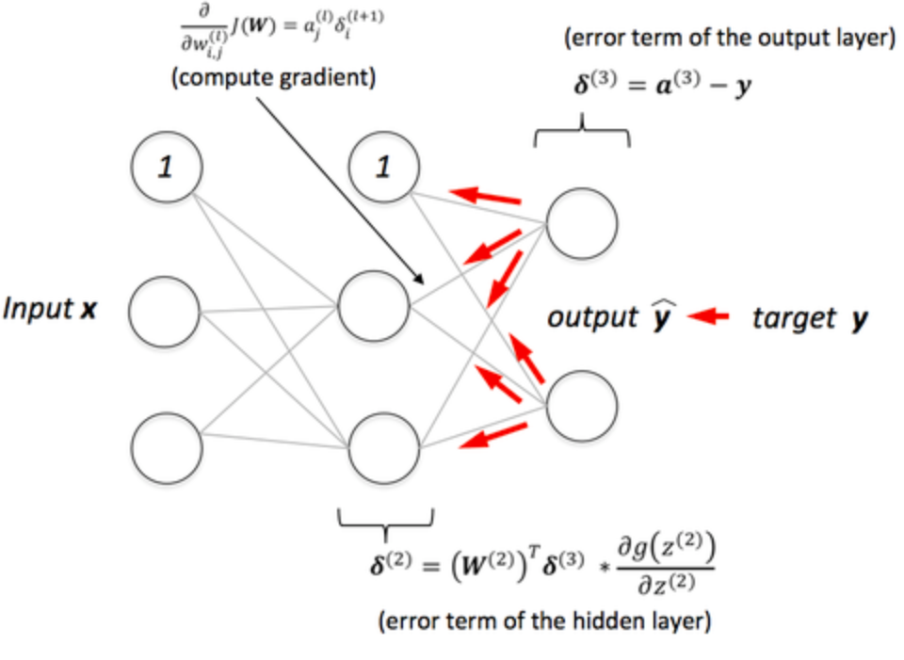
Back-propagation (gradient descent)
Gradient updates are computed in the direction from output to input layers.

Slide 20
Two key questions for back-propagation
How often the weights will be updated?
How the weights will be updated at each step?

Slide 21
How often weights are updated?
When you train a model, you need to specify how many samples you want to use per update. That is called batch size.
Online Training - Update the weights based on gradients from a single training record.
Vanilla Gradient Descent - Update the weights based on the gradients over all training records.
Batch Size Training- Update the weights at a time based on some batch size of training elements.
Mini-Batch Training - The same as batch size, but with a very small batch size. (Batch size defaults to 32 in Tensorflow/Keras).

Slide 22
Step v.s. Epoch
The batch size is smaller than the training data size, so it may take several batches to make it completely through the training set.
At each step (iteration), one batch was processed.
At each epoch, we went through the complete training set once. A single pass through the entire training set

Slide 23
How weights are updated per step?
Choose update rules (optimizers). There are a few variations of gradient descent you can choose from
TensorFlow allows the update rule to be set to one of:
Adam
Adagrad
Adadelta
Adamax
Momentum
Stochastic Gradient Descent (SGD)
Others
https://keras.io/optimizers/

Slide 24
Reflection on update rules (adaptive vs non-adaptive)
Each algorithm has its strengths and weaknesses.
For rapid prototyping, use adaptive techniques like Adam/Adagrad. These help in getting quicker results with much less efforts.
To get the best results, you should use Stochastic Gradient Descent (SGD). SGD is slow to get the desired results, but these results are mostly better than adaptive techniques.

Slide 25
Neural networks: pros and cons
Pros
Flexible and general function approximation framework
Can build extremely powerful models by adding more layers
Cons
Training is prone to local optimum.
Huge amount of training data, computing power required to get good performance
Implementation choices is huge (network architectures, parameters)

Slide 26
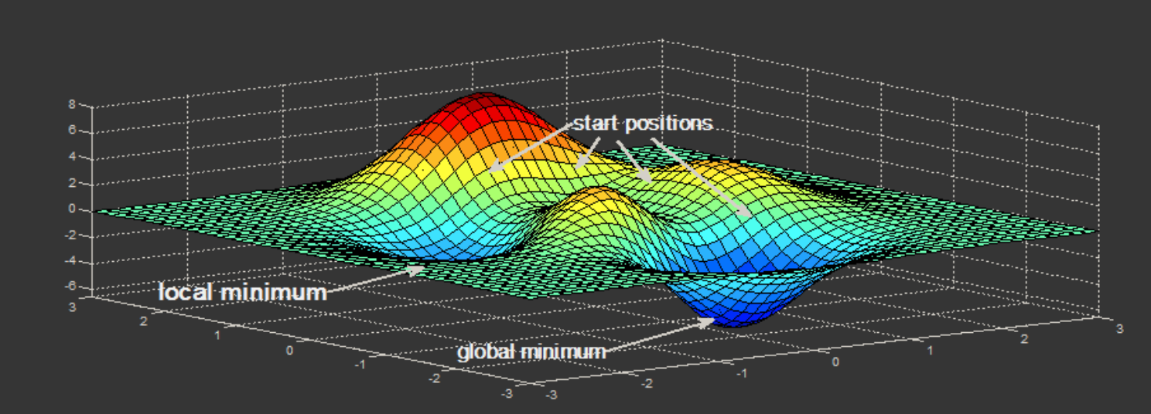
Gradient descent is prone to local optimum

Slide 27
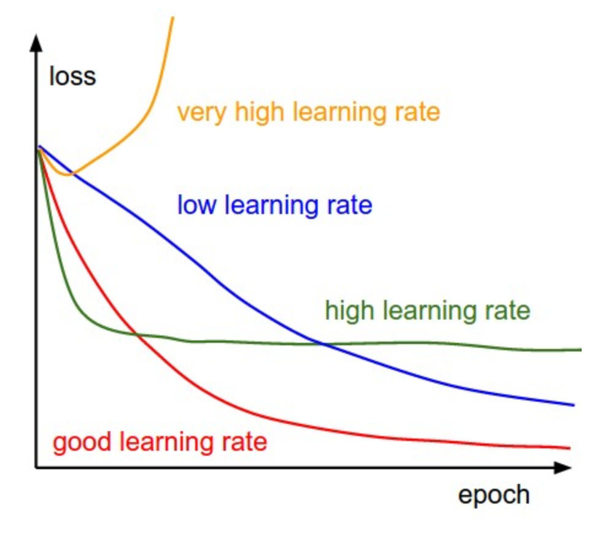
Pay attention to learning rate
https://www.benfrederickson.com/numerical-optimization/

Slide 28
Demo of gradient descent
https://lukaszkujawa.github.io/gradient-descent.html

Slide 29
Neutral network for image captioning
http://destiny.liacs.nl/

